Slide 1

Dynamics of Neural Population Activity During the Ready–Set–Go Task
By Gargi Ghosh
(Intern)
Under supervision of Prof. Daesoo Kim and ChangBum Ko

Slide 2
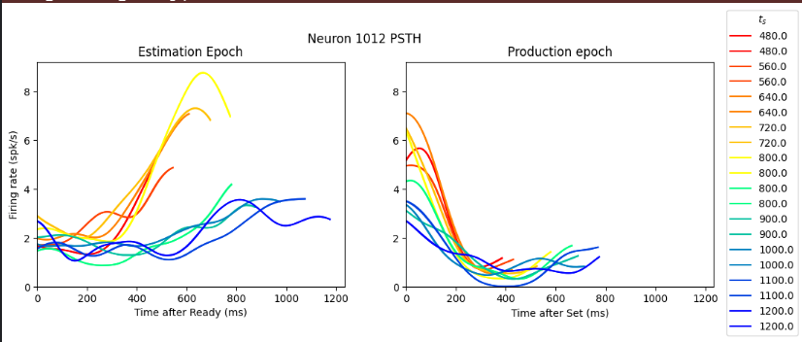
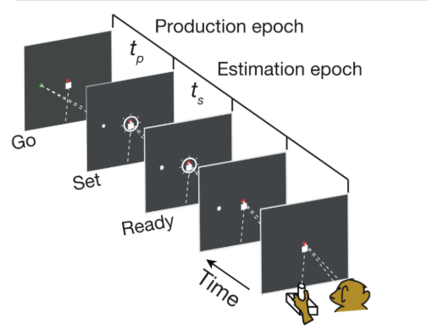
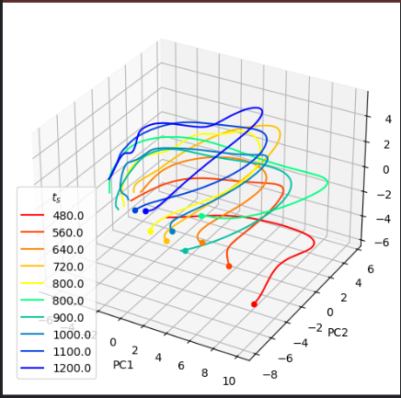
Dataset Used - DMFC_RSG: macaque dorsomedial frontal cortex spiking activity during time interval reproduction task
Individual neurons in the DMFC display a variety of complex time-dependent behaviors during both the estimation and production epoch of the ready-set-go task.

Slide 3
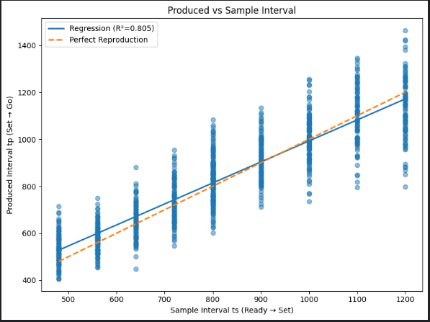
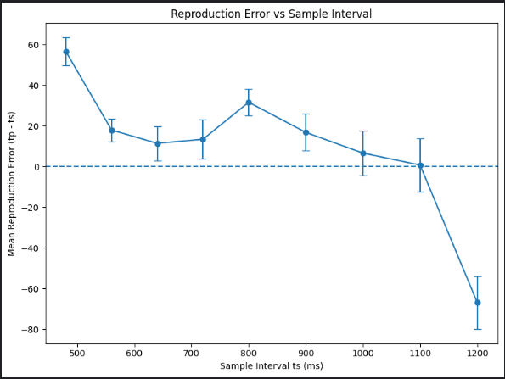
How does the DMFC transform sensory timing information into an internal neural representation that guides accurate time reproduction?
The frontal cortex of the brain stores the information as an estimate of the elapsed time rather than the exact copy of the physical timing.
Number of Trials: 983
Slope: 0.8939
Intercept: 98.9692
R² : 0.8052
Slope = -0.1043
R² = 0.6039
p-value = 1.3728e-02
The longer intervals were seemed to be reproduced slightly shorter whereas the shorter intervals were seemed to be reproduced slightly longer proving the Vierordt's law of the central tendency effect.
Behavioral analyses demonstrated a strong relationship between sample and reproduced intervals (R² = 0.805). However, reproduction errors varied systematically with interval length (slope = -0.104, p = 0.0137), indicating that timing behavior was influenced by an internal estimate of elapsed time rather than a perfect representation of the physical stimulus. This suggest that temporal information undergoes neural transformation before guiding behavioral output.

Slide 4
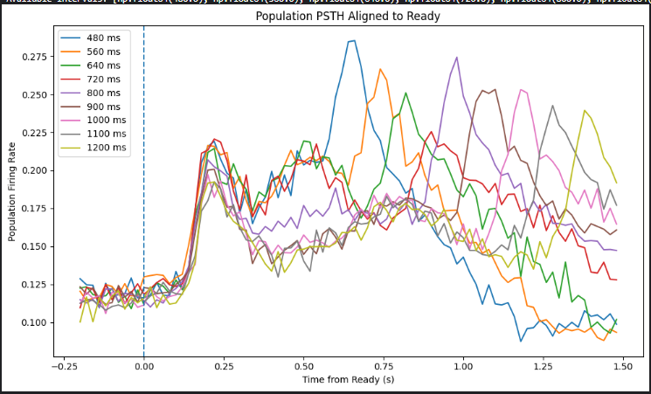
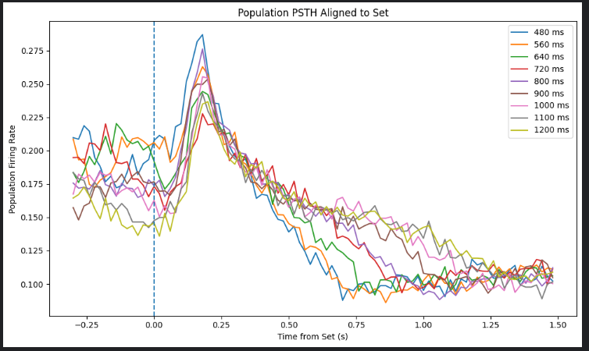
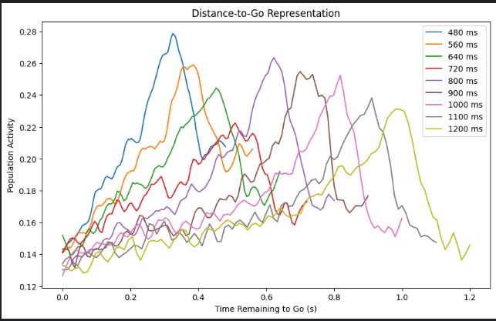
The shorter time interval (480-560 ms) conditions collapse earlier while longer time intervals (1000-1200 ms) remain active for longer period showing a slower decay suggesting that neural dynamics unfold at different speeds depending on the interval that must be reproduced.
The perceived interval is stored as a continuously evolving state instead of storing it as a static memory

Slide 5
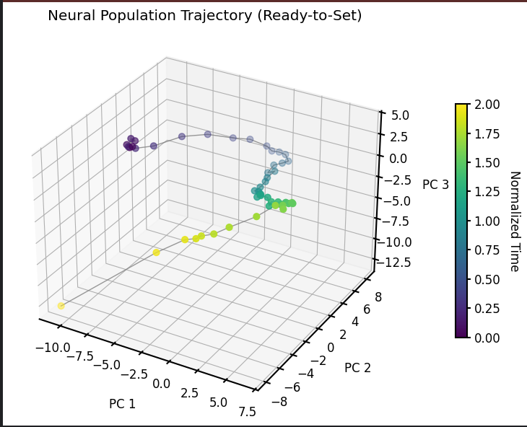
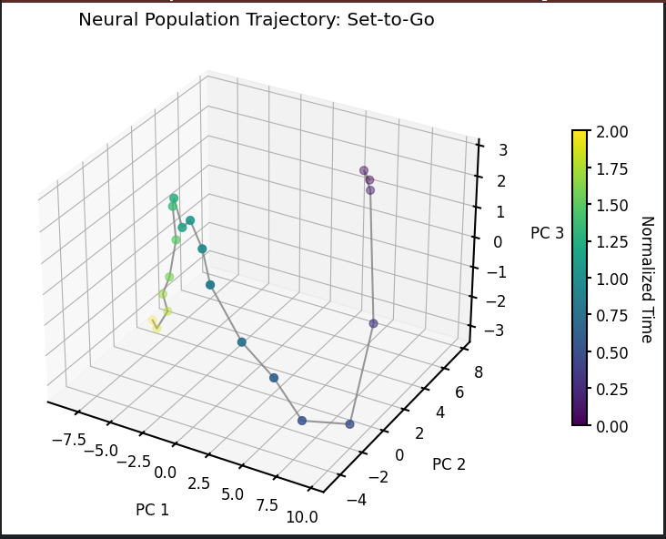
Timing is represented through evolving neural population dynamics, with distinct neural manifolds supporting interval encoding and interval reproduction
Analysis of neural population activity during the Ready-to-Set interval revealed a continuous trajectory through low-dimensional state space. Rather than remaining stationary following the Ready cue, neural activity evolved systematically over time, indicating that elapsed time was represented by the progression of population dynamics along a neural manifold. This observation is consistent with dynamical systems models of temporal processing, in which timing information is encoded through continuously changing neural states rather than static representations. The presence of an organized trajectory during interval measurement suggests that DMFC actively tracks elapsed time through internally generated population dynamics, providing a potential neural substrate for subsequent interval reproduction.

Slide 6
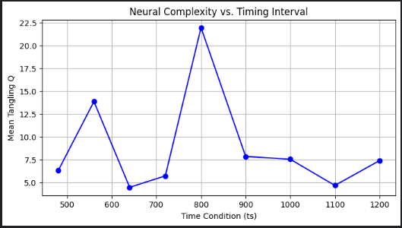
Time Condition (ts) | Mean Tangling | Median Tangling | Max Tangling
480.0 | 6.27 | 2.33 | 111.23
560.0 | 13.83 | 2.45 | 538.29
640.0 | 4.43 | 2.38 | 25.68
720.0 | 5.69 | 2.19 | 125.85
800.0 | 21.93 | 3.28 | 1083.75
900.0 | 7.82 | 4.60 | 44.61
1000.0 | 7.51 | 2.67 | 137.21
1100.0 | 4.64 | 2.74 | 31.17
1200.0 | 7.36 | 3.52 | 113.95
Mann-Whitney U p-value: 1.4152696845814793e-21, p < 0.001
delta_Q = -0.70
Epoch | Mean Q | Median Q | 95th Percentile Q
Measurement (Ready→Set) | 8.93 | 1.67 | 28.71
Production (Set→Go) | 8.50 | 2.85 | 21.39
These results suggest that neural dynamics during Production are consistently more complex, whereas Measurement dynamics are generally smoother but occasionally undergo large state transitions, suggesting that the brain utilizes non-autonomous, gated dynamics to perform timing computations
Tangling quantifies the consistency of neural dynamics by measuring whether nearby neural states evolve in similar directions. Lower tangling indicates smoother and more autonomous dynamics, whereas higher tangling suggests that similar neural states can lead to different future trajectories.

Slide 7
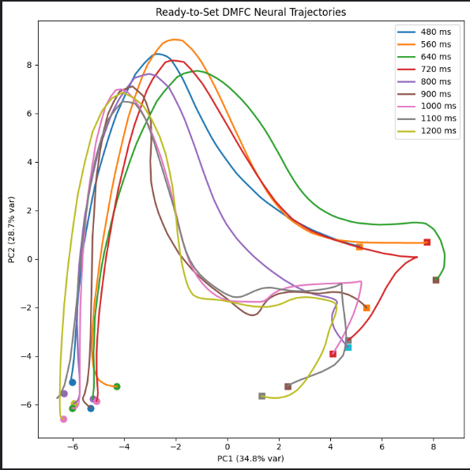
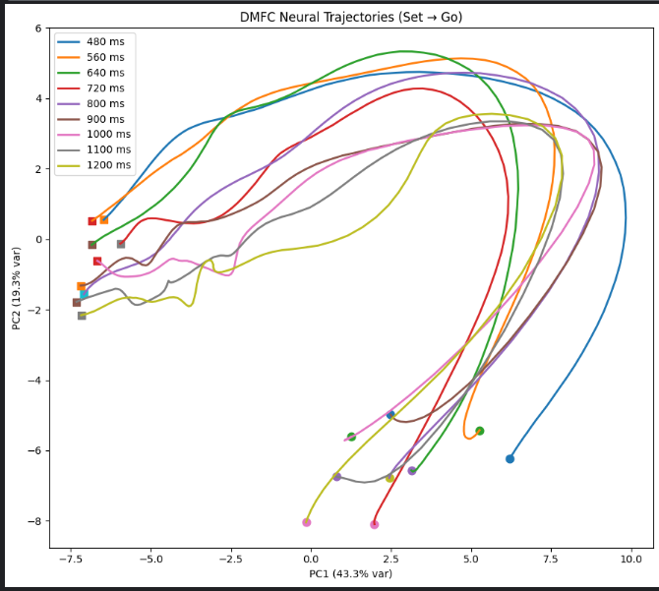
Do neural trajectories converge to a common state before and after Go, regardless of interval length?
Reproduction is not controlled by a single fixed firing threshold because the end points don’t converge/ overlap at the one point.
PC1 variance explained: 43.35%
PC2 variance explained: 19.29%
PC3 variance explained: 10.22%
Total (PC1+PC2): 62.63%
Total (PC1+PC2+PC3): 72.85%
PC1+PC2 variance explained: 63.49876353215467
DMFC follows temporal scaling ?

Slide 8
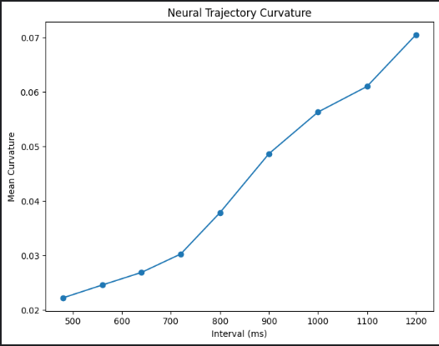
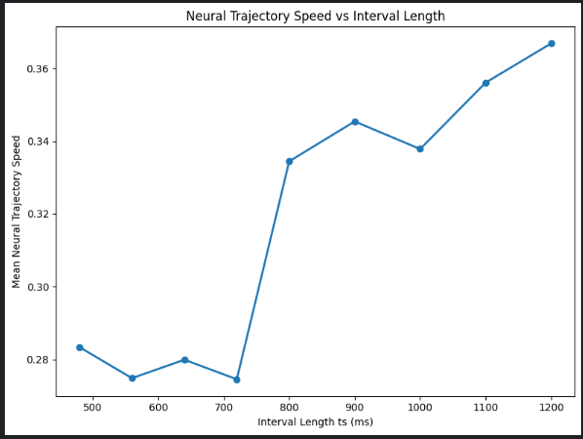
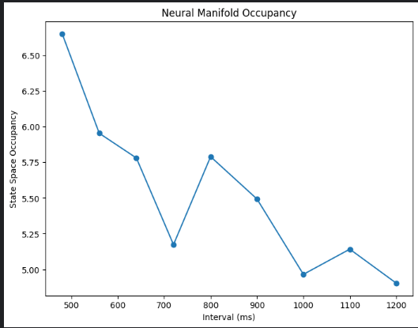
Longer intervals are not represented by exploring a larger neural space.
Longer intervals are represented by taking a more complex route through approximately the same neural space.
Correlation: 0.9141586034445451
ts speed
0 480.0 0.283329
1 560.0 0.274827
2 640.0 0.279902
3 720.0 0.274519
4 800.0 0.334442
5 900.0 0.345423
6 1000.0 0.337826
7 1100.0 0.356091
8 1200.0 0.366875
ts curvature
0 480.0 0.022210
1 560.0 0.024561
2 640.0 0.026870
3 720.0 0.030243
4 800.0 0.037823
5 900.0 0.048632
6 1000.0 0.056263
7 1100.0 0.060953
8 1200.0 0.070453
ts occupancy
0 480.0 6.651488
1 560.0 5.953479
2 640.0 5.780364
3 720.0 5.173346
4 800.0 5.789598
5 900.0 5.492874
6 1000.0 4.964828
7 1100.0 5.141375
8 1200.0 4.903562

Slide 9
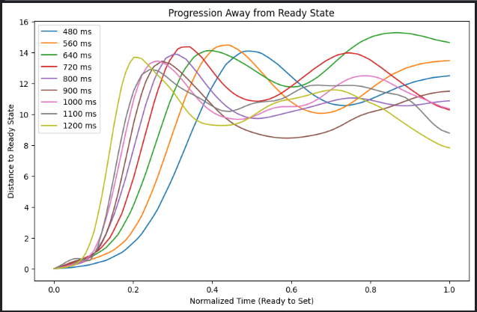
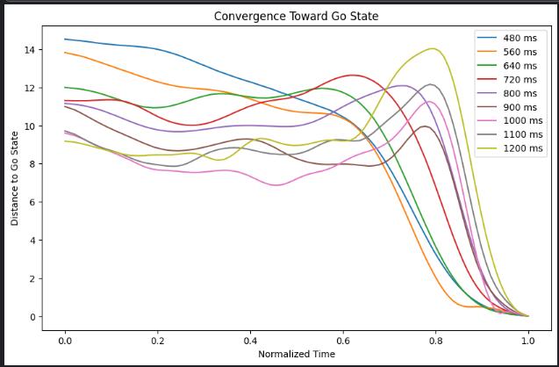
timing behavior is governed by internal neural dynamics rather than a simple sensory response
DMFC preserves interval-specific temporal information during interval encoding
In the Set convergence state, every trajectory begins from a separate state space and all conditions exhibited a distant separation among themselves after the peak.
Output convergence/ movement invariant
In the Go convergence state, despite beginning from different regions of state space and following distinct trajectories, all conditions exhibited a rapid reduction in distance immediately preceding movement initiation.
Interval-specific information is transformed into a common movement-execution representation

Slide 10
Converge towards the Ready State
Converge towards the Go State
Interval (ms) | Mean Distance | Min Distance (Convergence) | Max Distance | Std Dev
480 | 8.589285 | 0.0 | 14.093250 | 4.996660
560 | 9.161250 | 0.0 | 14.480232 | 4.908069
640 | 10.539520 | 0.0 | 15.287977 | 5.242636
720 | 9.964909 | 0.0 | 14.373720 | 4.554704
800 | 9.129877 | 0.0 | 13.888022 | 3.912277
900 | 8.681438 | 0.0 | 13.437705 | 3.702955
1000 | 9.562182 | 0.0 | 13.451455 | 3.850856
1100 | 9.555201 | 0.0 | 12.905279 | 3.743556
1200 | 9.246513 | 0.0 | 13.689763 | 3.479004
Interval (ms) | Mean Distance | Min Distance (Convergence) | Max Distance | Std Dev
480 | 8.148 | 0.0 | 12.503 | 4.365
560 | 8.870 | 0.0 | 14.011 | 5.020
640 | 8.658 | 0.0 | 14.646 | 5.170
720 | 7.078 | 0.0 | 13.516 | 3.977
800 | 6.688 | 0.0 | 13.856 | 4.627
900 | 7.950 | 0.0 | 13.138 | 4.087
1000 | 7.514 | 0.0 | 13.843 | 3.914
1100 | 6.976 | 0.0 | 13.432 | 3.491
1200 | 6.156 | 0.0 | 13.622 | 3.435
Distance = $\sqrt{\{{(PC1t − PC1go)}^{2} + {(PC2t − PC2go)}^{2}+ {(PC3t − PC3go)}^{2}\}}$

Slide 11
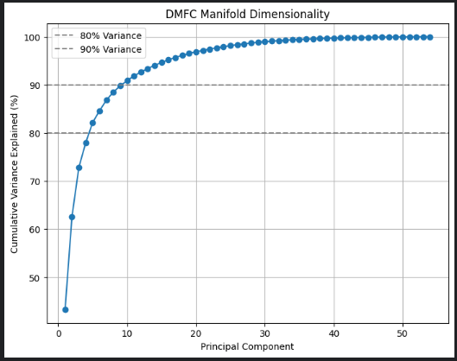
PC1: 43.35%
PC2: 19.29%
PC3: 10.22%
PC4: 5.15%
PC5: 4.17%
PC6: 2.47%
PC7: 2.20%
PC8: 1.69%
PC9: 1.28%
PC10: 1.07%
The cumulative variance analysis revealed that DMFC activity occupies a low-dimensional manifold, with approximately 73% of neural variance captured by the first three principal components and nearly 90% captured by the first ten components. These findings indicate that interval reproduction is governed by coordinated population dynamics rather than independent neuronal responses, supporting that temporal information is encoded through low-dimensional neural trajectories.
Low-dimensional structure is a hallmark of neural dynamical systems and has been reported in motor cortex, premotor cortex, and dorsomedial frontal cortex during timing tasks.

Slide 12
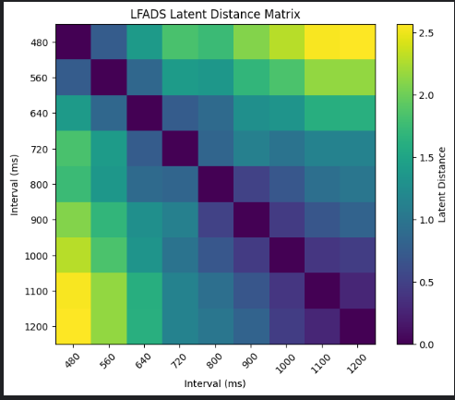
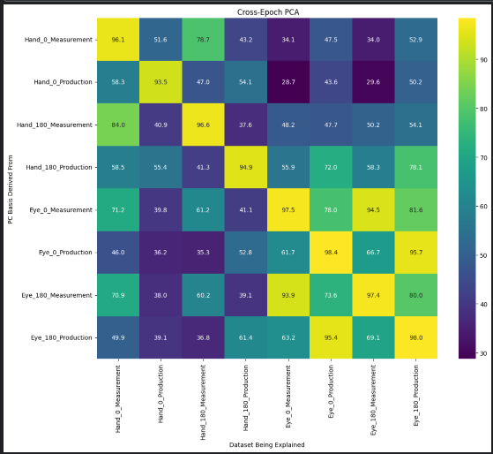
R² = 0.7359914030413754
Neighboring intervals showed relatively small distances, whereas intervals separated by larger temporal differences exhibited progressively larger distances. The largest distances were observed between the shortest and longest intervals (480 ms and 1200 ms).
Similar interval durations occupied nearby regions of latent space, while increasingly different intervals became progressively separated.
Hand-related activity carries more direction-specific information than Eye-related activity
The eye-related timing representation is relatively stable across Measurement and Production epochs

Slide 13
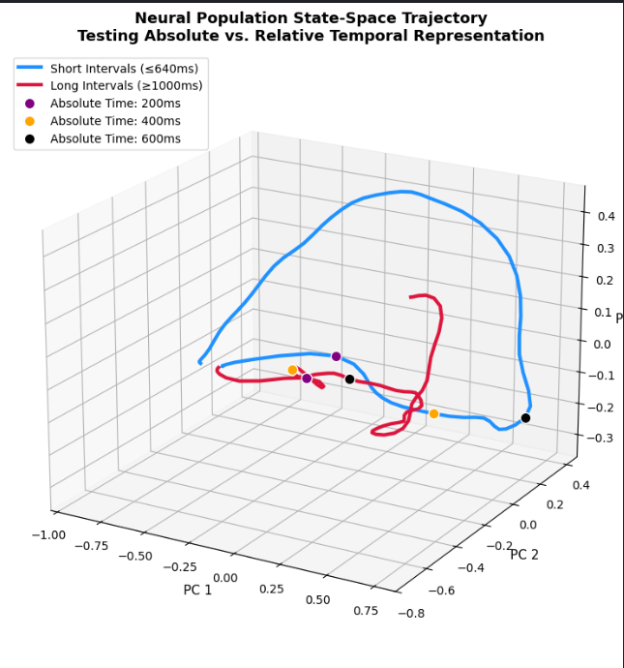
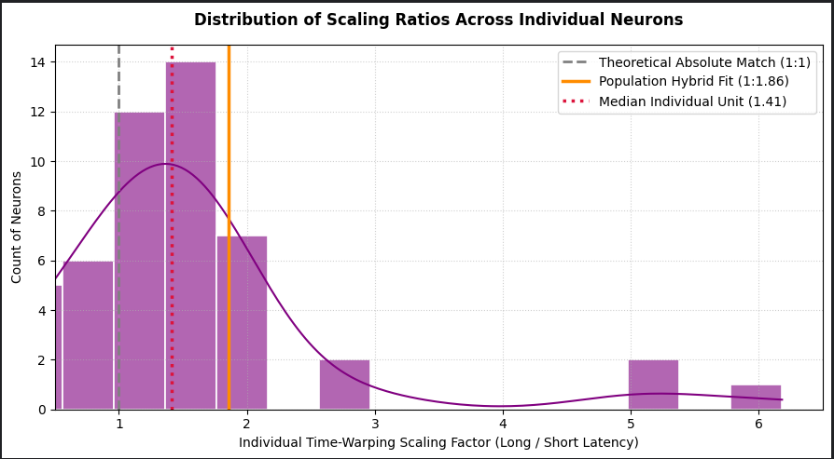
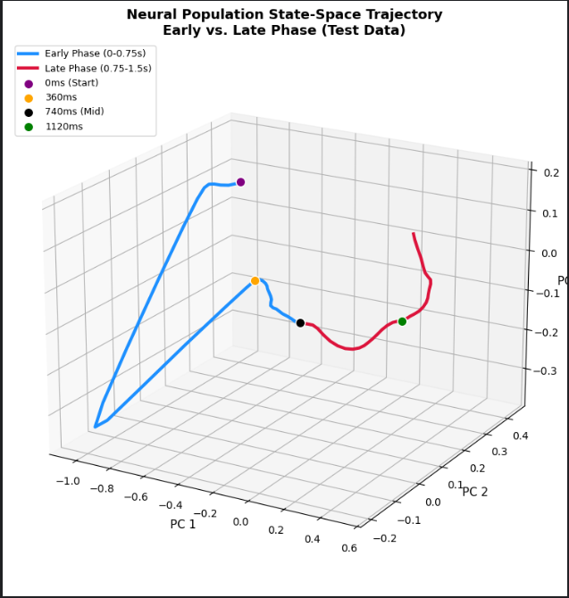
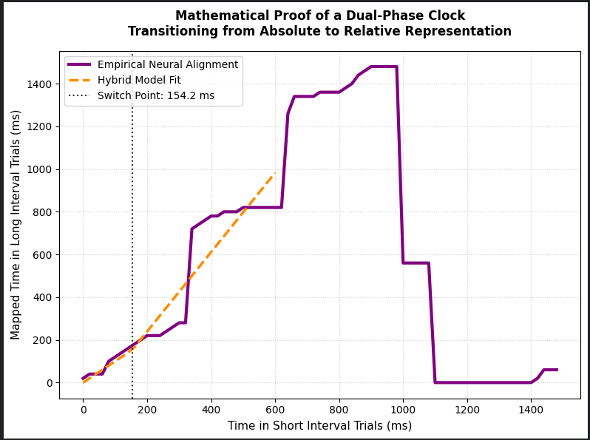
Supporting figures
Percentage of timing-responsive neurons that scale (> 1.0): 71.4%
interval reproduction is associated with progressive evolution of neural population dynamics rather than static representations of elapsed time
temporal information is represented through interval-dependent neural dynamics

Slide 14
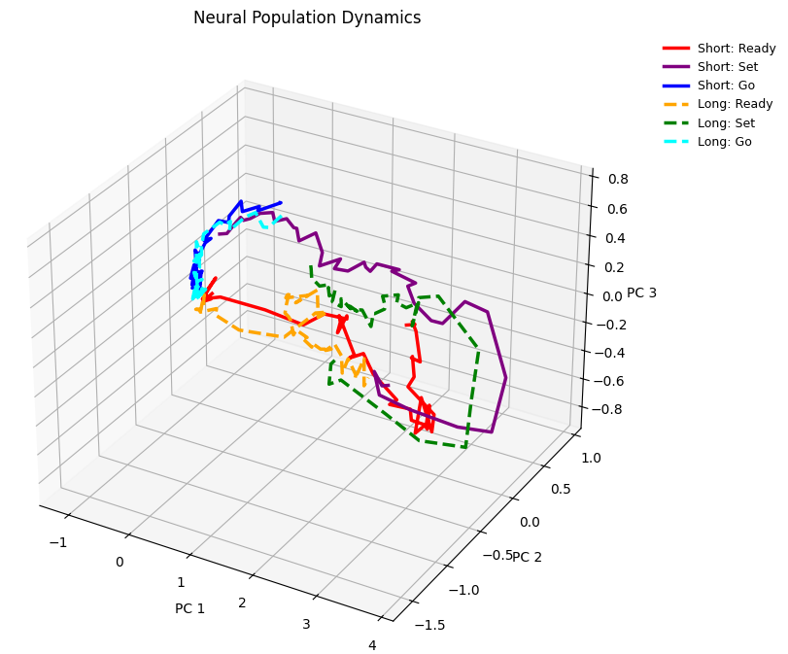
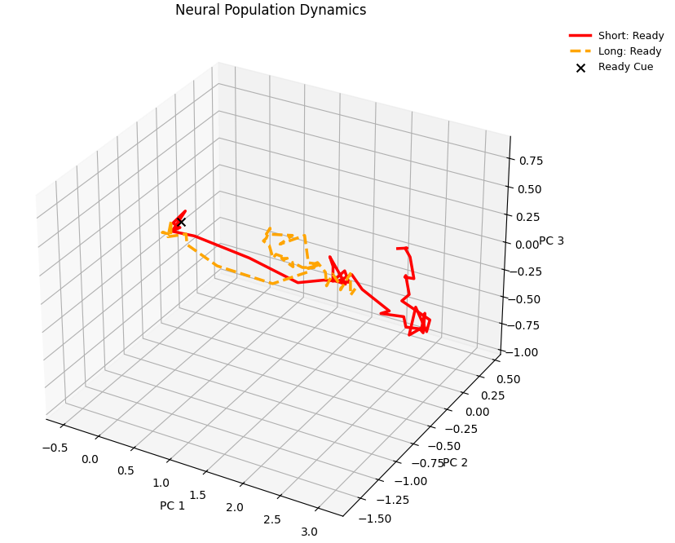
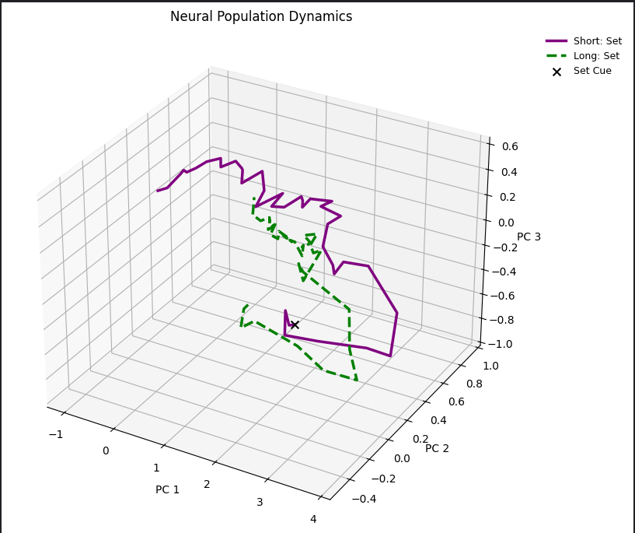
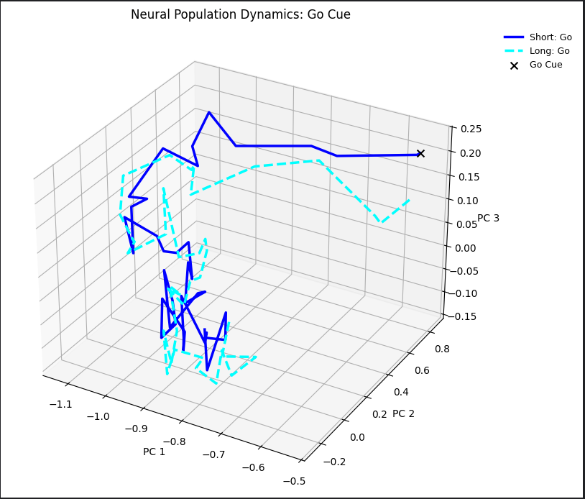
Supports - temporal information is represented through internally generated low-dimensional neural dynamics rather than static sensory or stimulus-locked activity patterns.

Slide 15
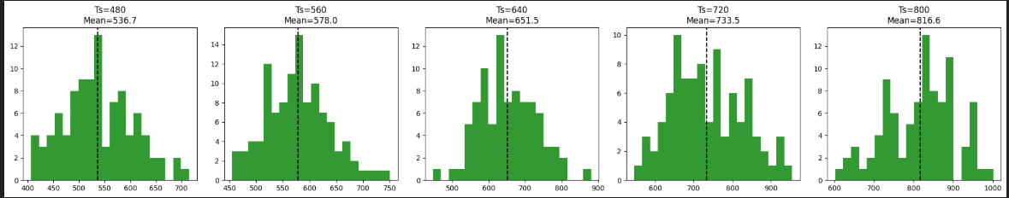
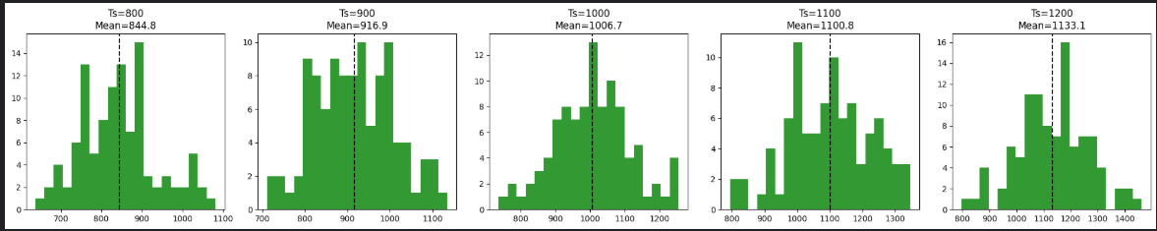
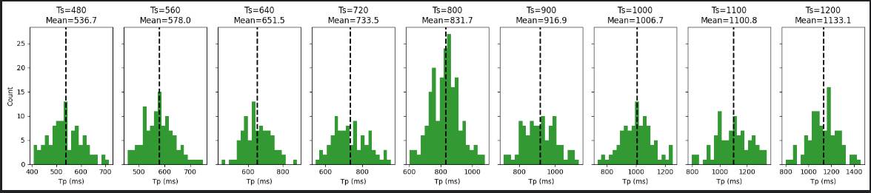
Across all trials where the sample interval was 800 ms, how were the produced intervals distributed?

Slide 16
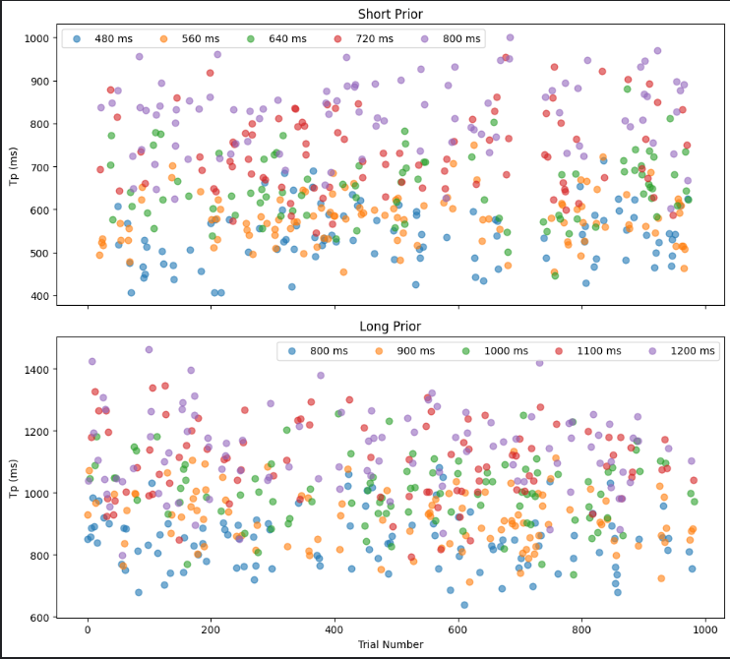
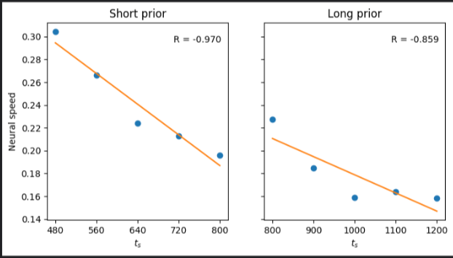
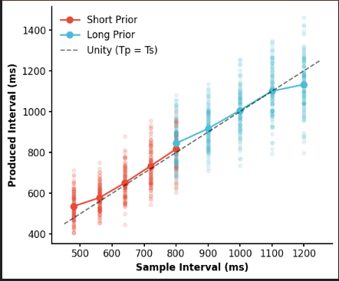
Neural speed is negatively correlated with the sampling interval. However, this trend only appears to hold within the short or long prior conditions. This aligns with the observation that single-neuron responses and neural trajectories are most similar within the same prior.

Slide 17
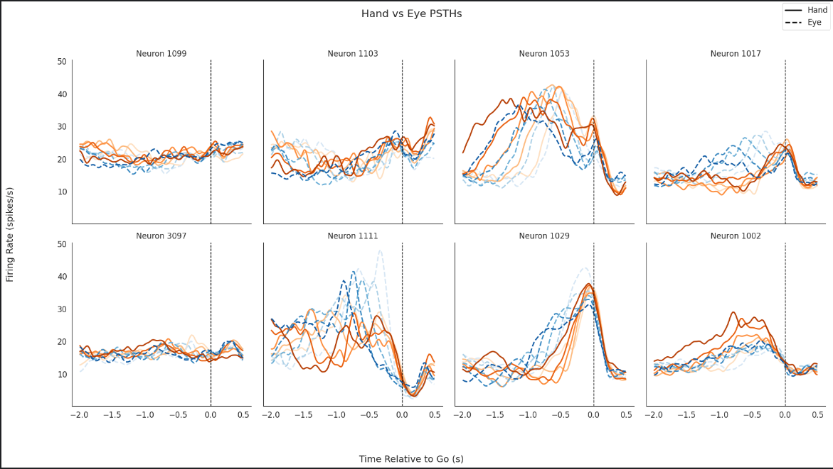
top 8 most modulated neurons
Average firing rates were computed after aligning spike times to movement initiation time

Slide 18
THANK YOU

